Slide 1
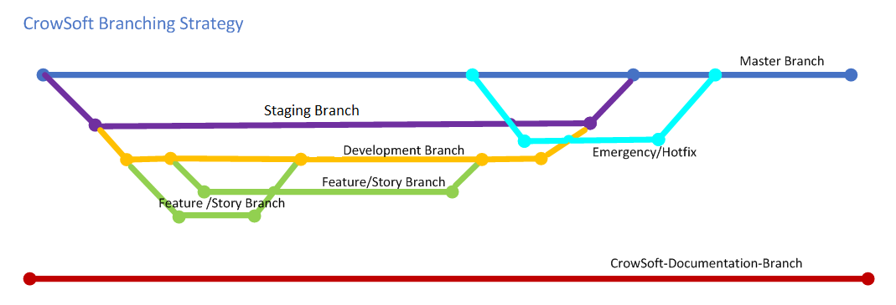
Git & Github
GitHub https://github.com/rlennon/CrowSoft

Slide 2
CrowSoft Jenkins Pipeline
GitHub
CrowSoft
Jenkins Server
Workspace
Testing
Artifactory
Ansible
Dev Server

